Slide 1
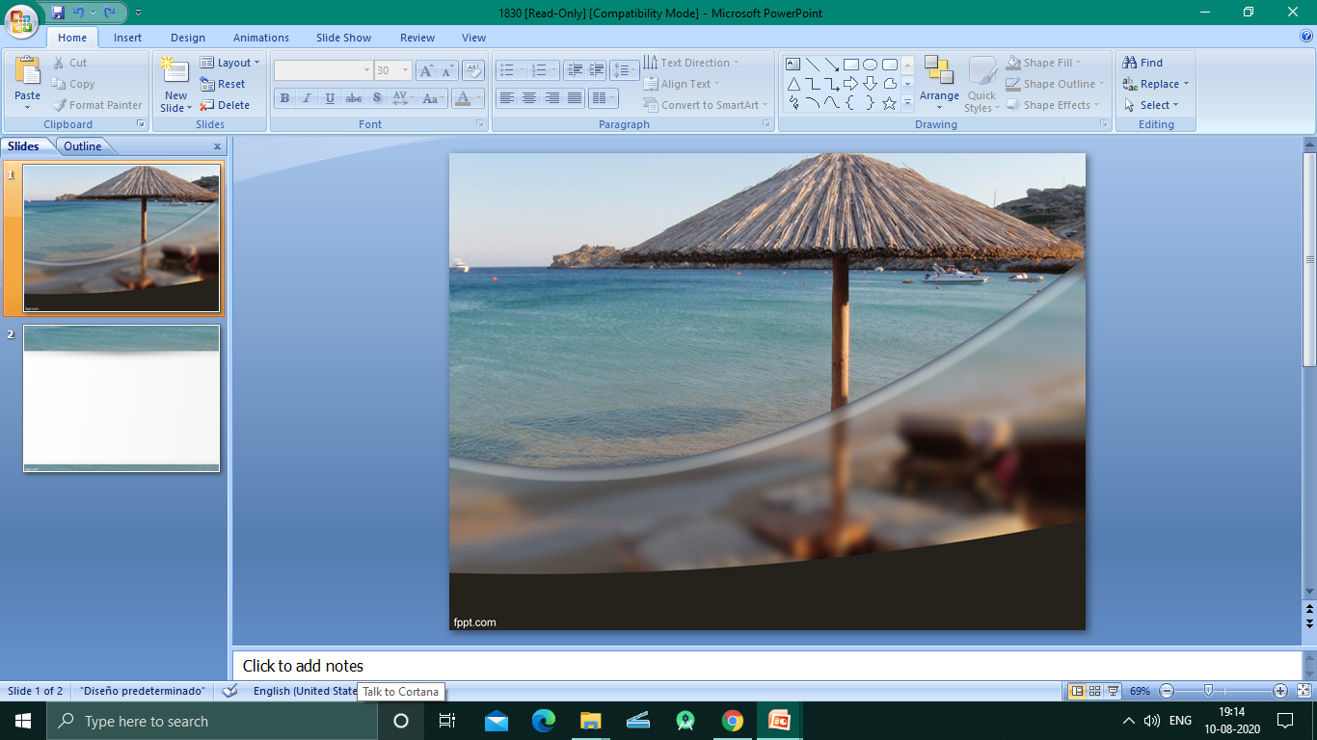
TOURS & TRAVEL MANAGEMENT SYSTEM
Notes:
© Copyright PresentationGO.com – The free PowerPoint and Google Slides template library

Slide 2
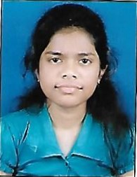
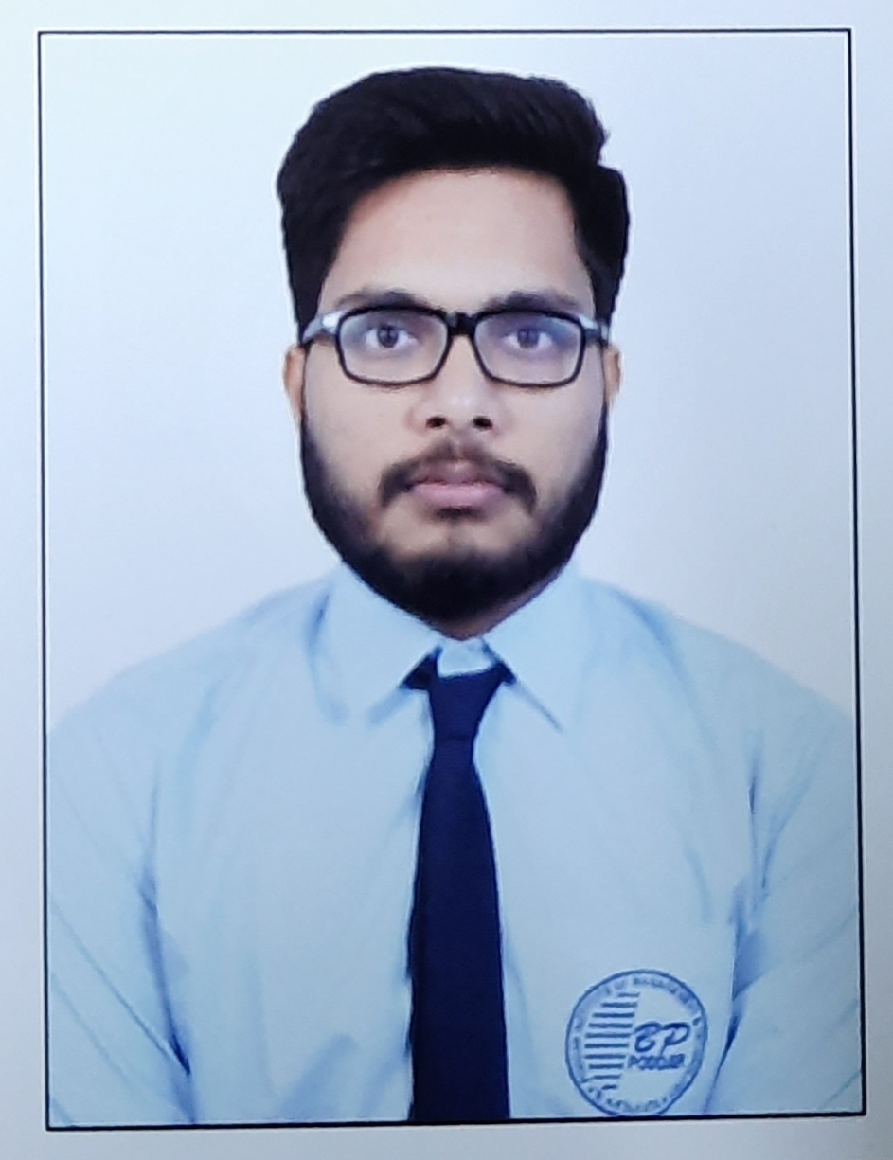
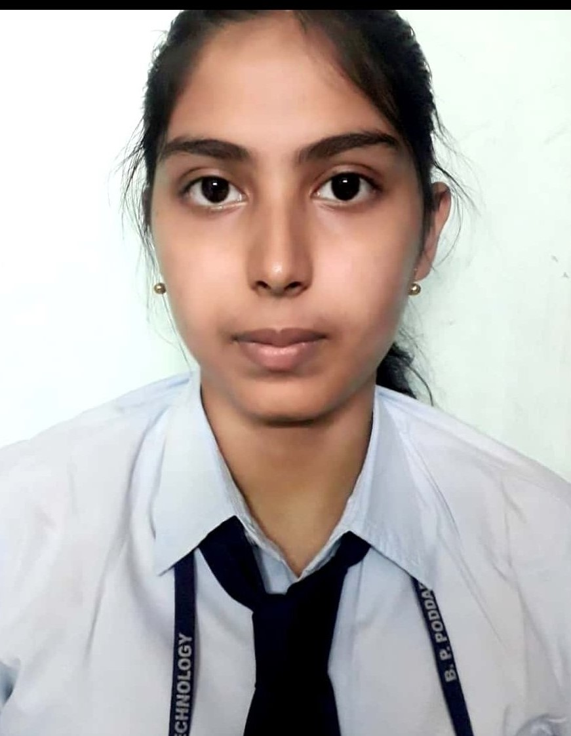
PRESENTED BY
Debduti Mondal
BPPIMT
Apurba Paul
BPPIMT
Amrita Dey
BPPIMT

Slide 3
Introduction
The main purpose of this desktop application is to facilitate the offline customer because customers cannot spend their precious time in markets trying to find out the best deal.

Slide 4

Project Objective
Develop a software system for “Tourism and Travel” domain which facilitated management of different domain of travel and tourism . Like “Room Management”, “Human Resource Management”, “Marketing Management”.
This software aims for considerable cost reduction for business owner.
Project scope
Our main aim is to develop a software on “Room Management” system.
Here new hotel can be added with details of it’s location, total no of ac and non-ac rooms.
When the customer comes to us to book room first the availability of room will be checked.
Then if available then the room will be allocated to the customer otherwise no allocation.
After the allocation of the rooms the room details will be updated.
Thus the room details will be kept in the storage file.
4

Slide 5
FUncTIONS REQUIRED
This “Tours & Travel Management System” has been designed to computerize the following functions that are performed by the system:
Customer details function
Room details function
Opening a new room
Sign up of new customer
Booking details function
Opening a new hotel
Hotel details function
Check in function
Room assigning to customer’s need
Room occupancy details functions

Slide 6
Business concept
Here the details of hotels in various location will be stored.
It is a desktop application so data will be entered from the user side.
The minimum requirement to access the application is a normal desktop with JDK installation. The memory requirement is very minimum.
The customers can book hotel in advance.
If a customer is already contact with us then the details of him/her is already in our database.
The data are well organised , well maintained and easy to access.

Slide 7
Software Requirements
OS: Windows 7 Or Later, Linux, Mac OS
Software: JDK 11 or Later
Hardware Requirements
Processor: Intel Pentium II or More
RAM:2GB
Hard Disk: 20GB or More
7

Slide 8
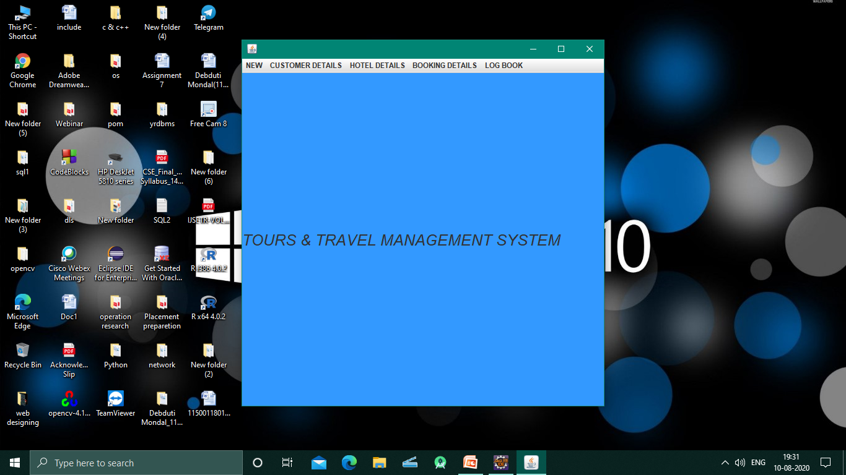
PROCESS:
Notes:
© Copyright PresentationGO.com – The free PowerPoint and Google Slides template library

Slide 9
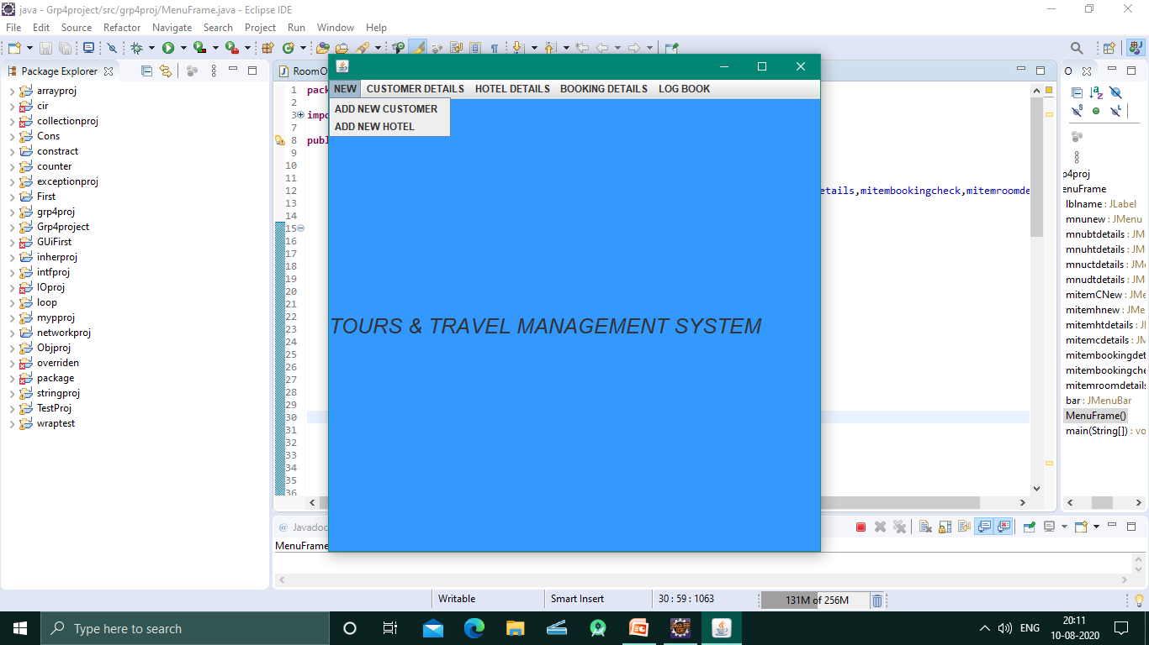
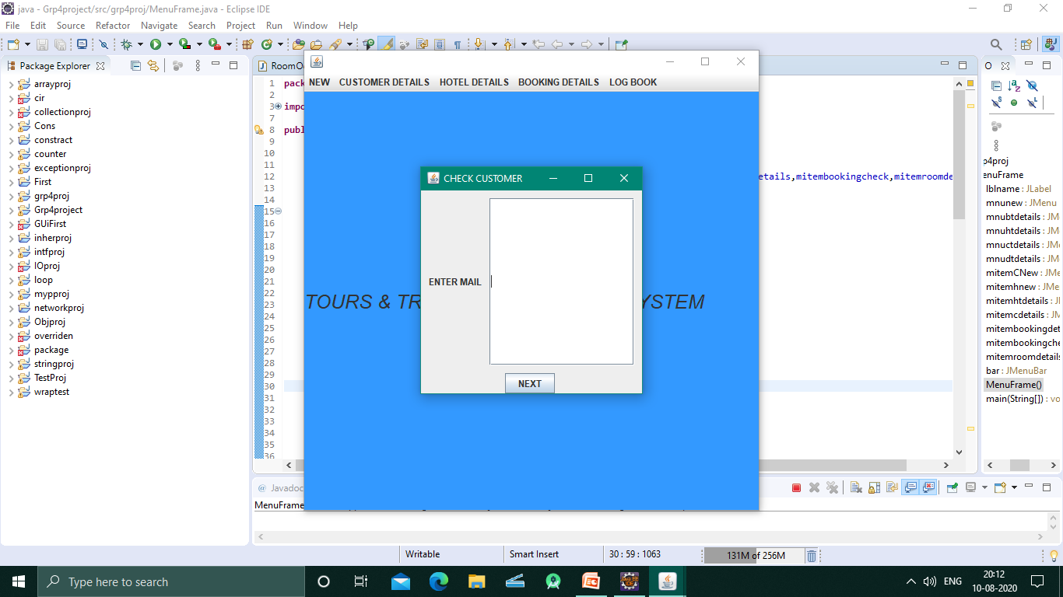
9
Notes:
© Copyright PresentationGO.com – The free PowerPoint and Google Slides template library

Slide 10
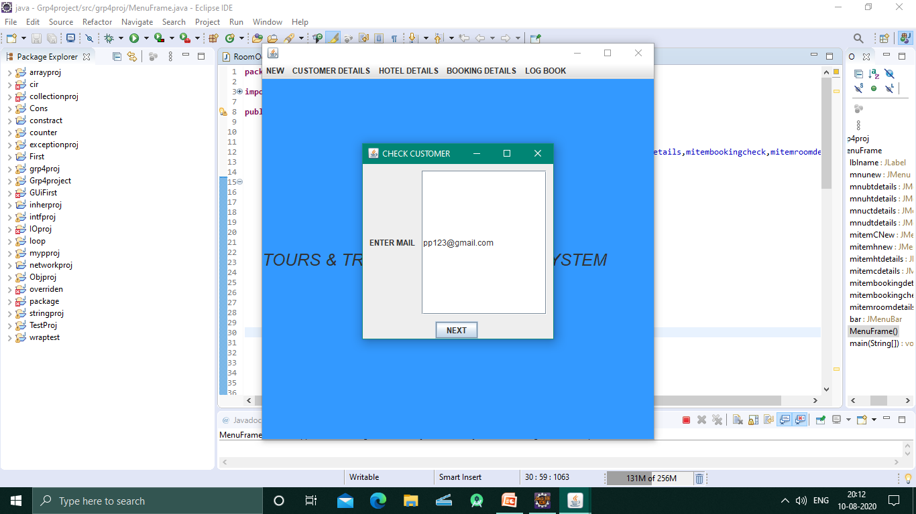
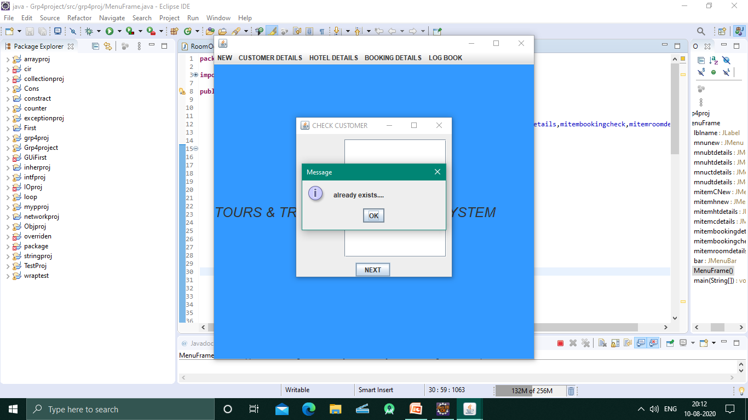
10

Slide 11
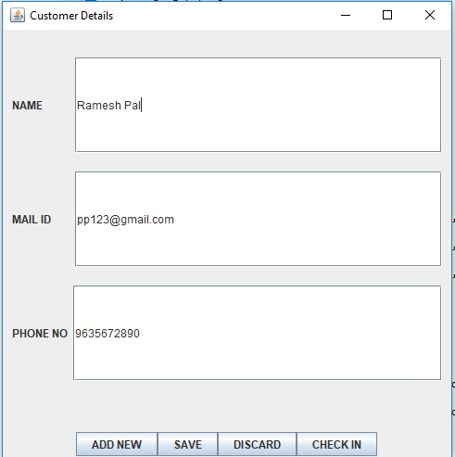

Slide 12
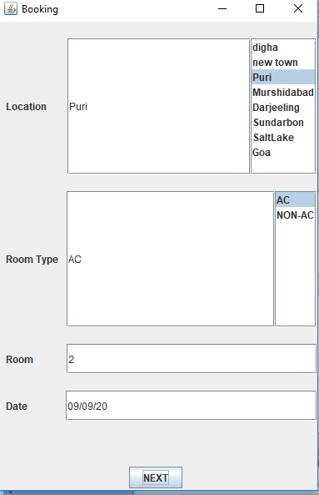
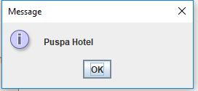

Slide 13
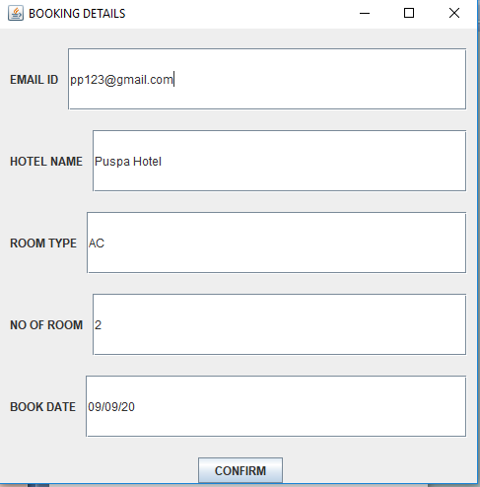
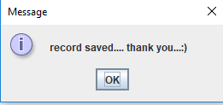

Slide 14
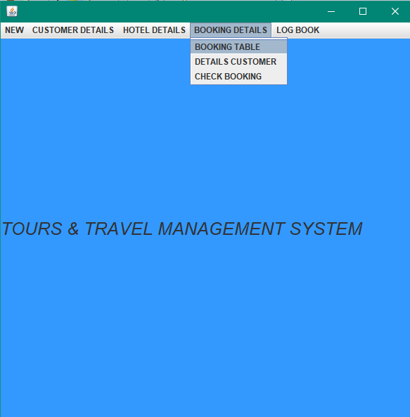
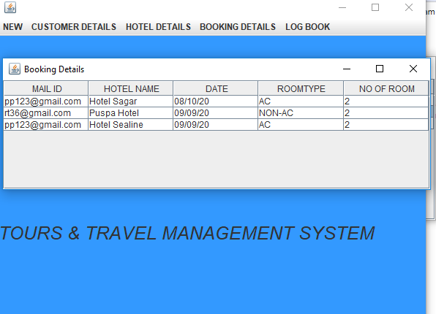
14

Slide 15
15
Notes:
© Copyright PresentationGO.com – The free PowerPoint and Google Slides template library

Slide 16
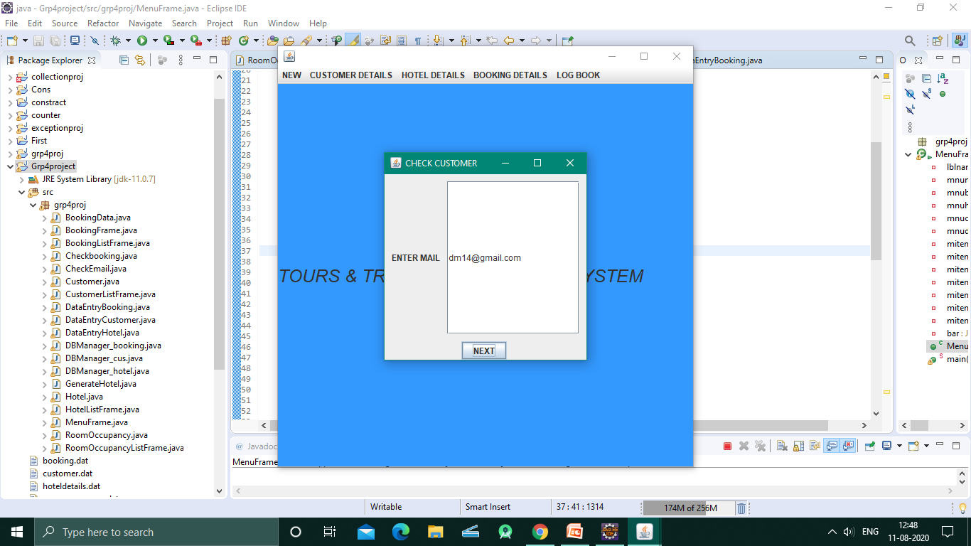
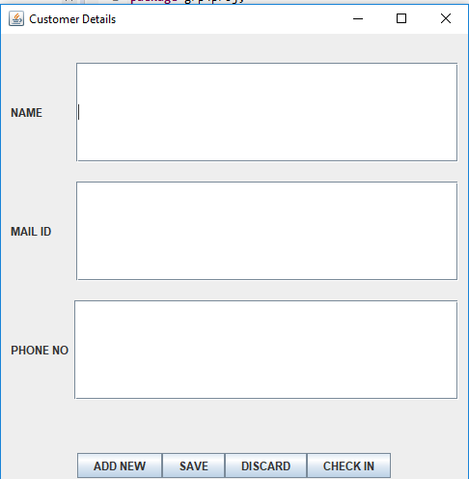
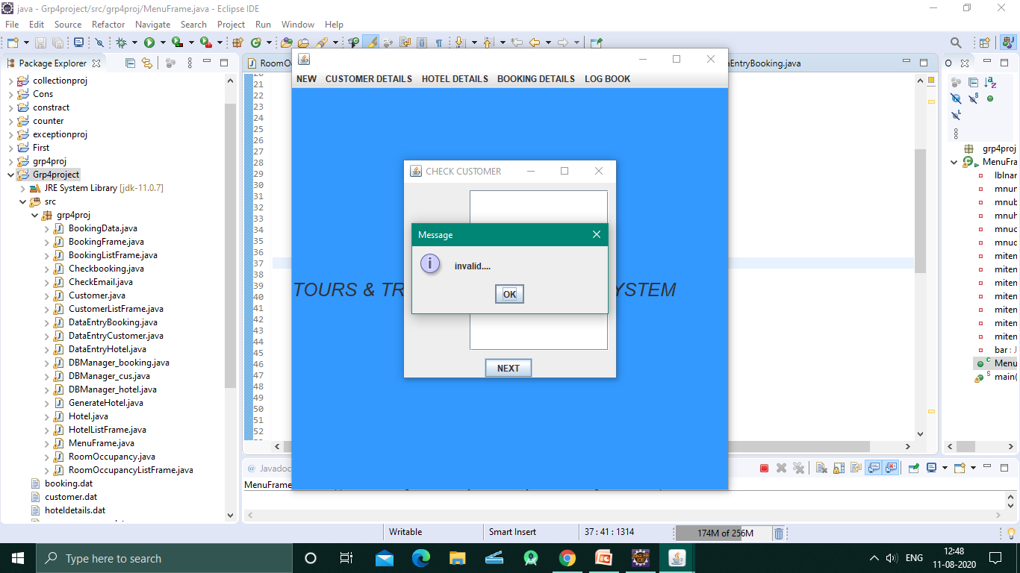

Slide 17
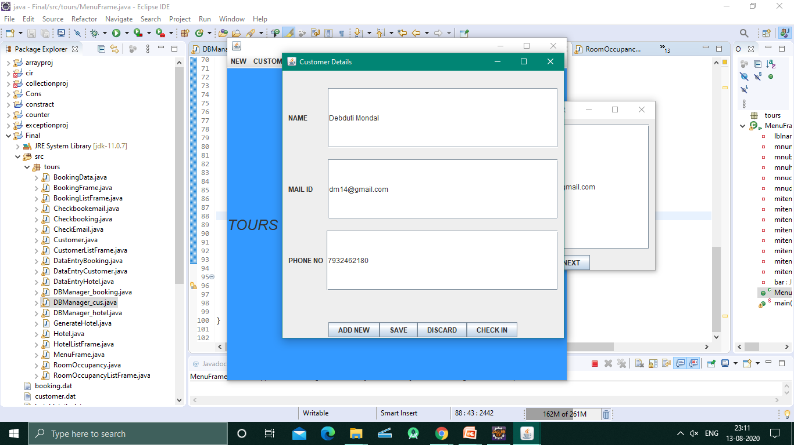
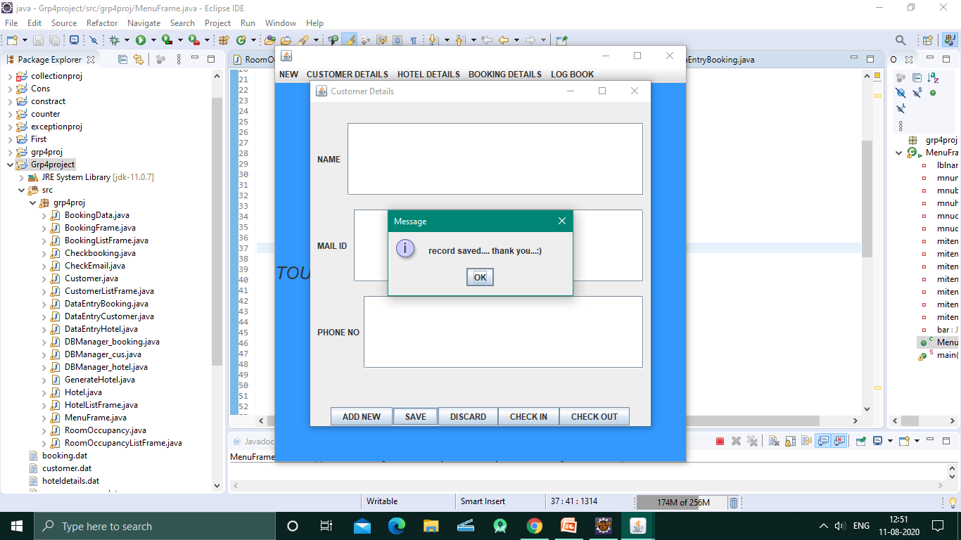
17

Slide 18
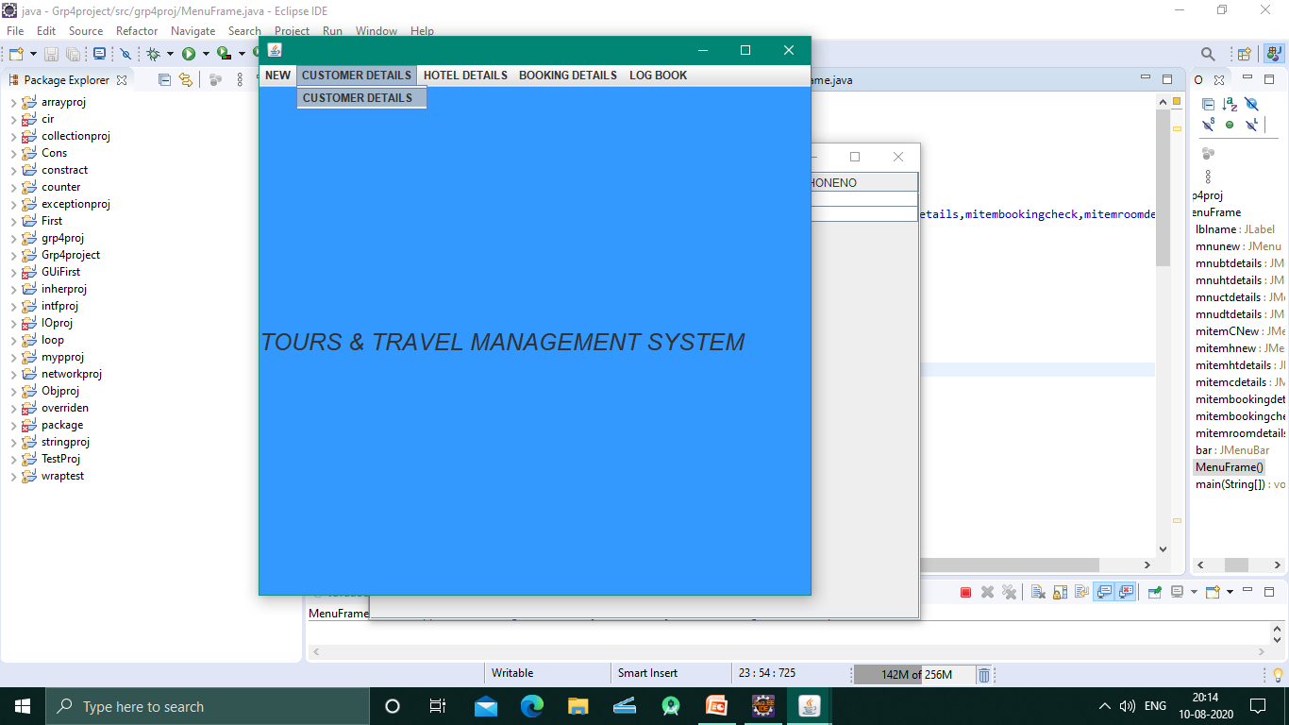
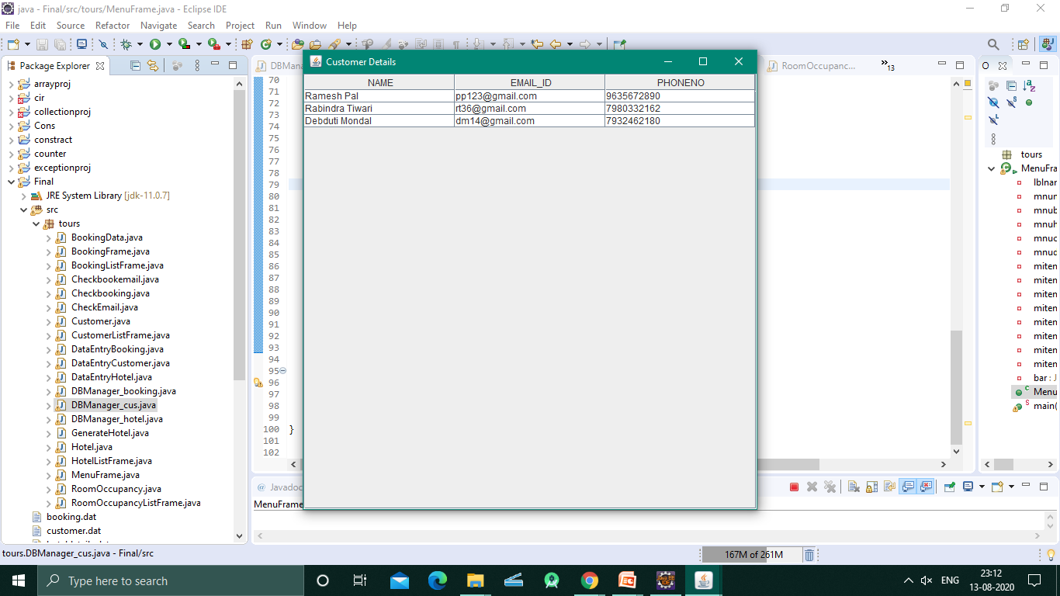
18

Slide 19
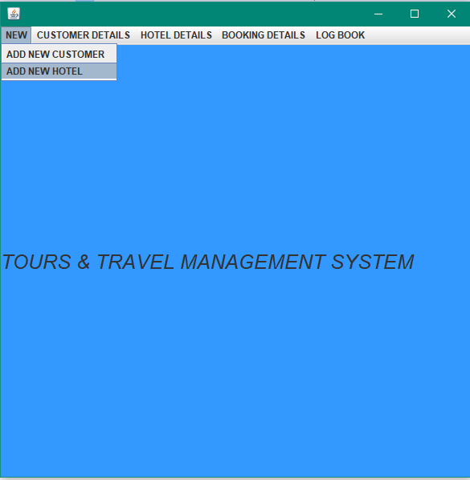
Notes:
© Copyright PresentationGO.com – The free PowerPoint and Google Slides template library

Slide 20
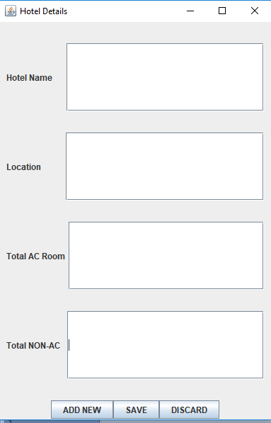
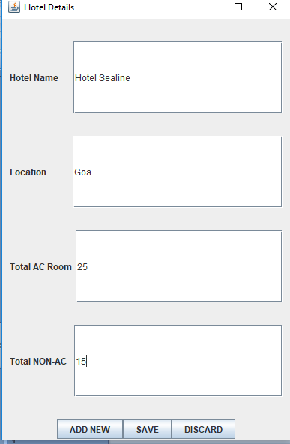
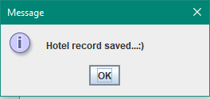

Slide 21
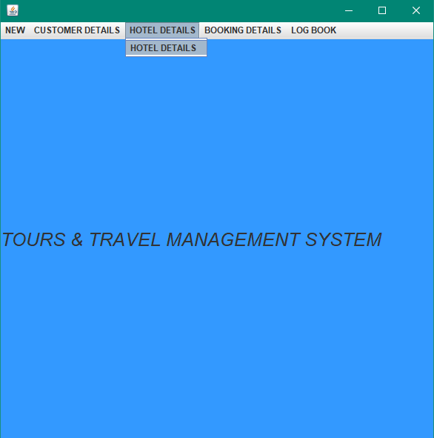
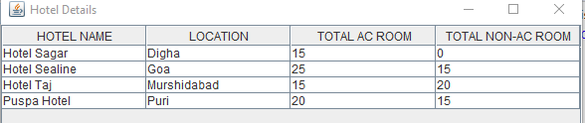

Slide 22
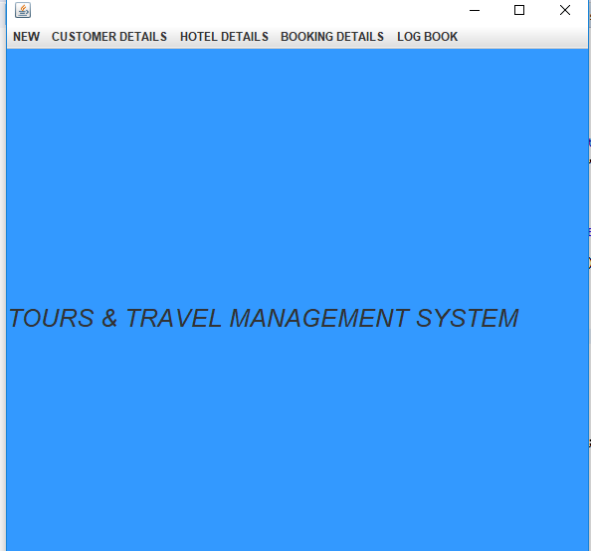
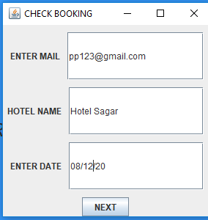
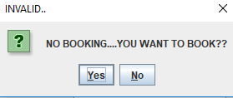
22
Notes:
© Copyright PresentationGO.com – The free PowerPoint and Google Slides template library

Slide 23
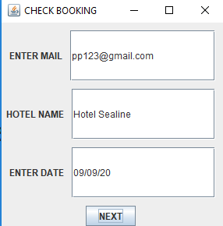
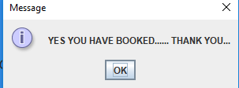

Slide 24
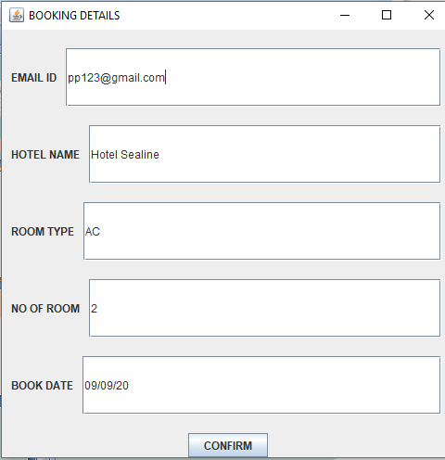
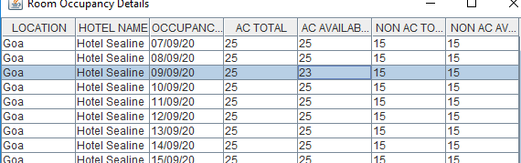
24

Slide 25
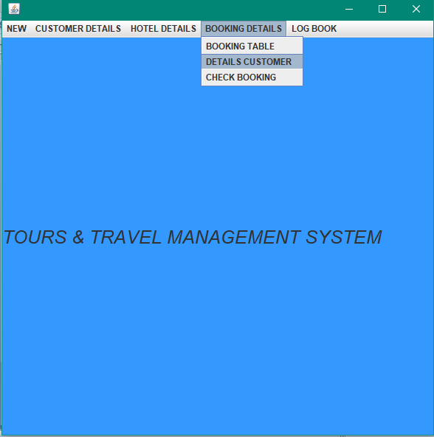
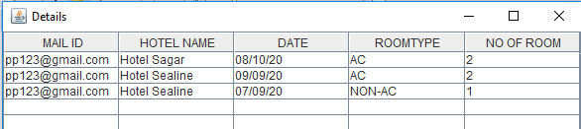

Slide 26
Future Implementation:
Human resource and marketing domain can be developed further.
After booking a confirmation mail should be included to the customer.
Keep a route map.
Further more hotels can be added in various location.
Improve the business policy to keep the quality intact.

Slide 27

Notes:
© Copyright PresentationGO.com – The free PowerPoint and Google Slides template library

